Slide 1


Degrees of Climate Change Project Summary
5 June 2018
Todd Schultz, Rahul Birmiwal, Abhishek Anand

Slide 2
Outline
Background
User persona/Research Questions
Data Sources
Demo
Design
Project Structure. Show the structure of your github repository.
Lessons learned and future work

Slide 3
Background
Climate change, fundamentally, is defined by
Historical changes in statistical properties of a climate system(s)
Often measured by sample mean/sample variance (spread) of historical global temperatures
Does climate change equal global warming and what caused it?
Ramifications reach to the ability of planet to support life
Corrections cost enormous sums of money
Corrections threaten entire industries and nations
What’s the true in the data?
Factbook database, such as the World Bank, is "centrist"; perhaps that from
NOAA (National Oceanic and Atmospheric Administration), or Berkeley Earth given their sources of funding as bastions of progressive change, are biased towards data evincing global warming
China, Russia, the Middle East, whose economies wholly depend on the prolonged sustenance of oil, tend towards conservative climate estimates

Slide 4
Background
So who watches the watchers?

Slide 5

Sally the Scientist, Activist
Concerned about climate change
Professional scientist, engineer, or mathematician
Self exploration
Novice with computer languages
Novice with web service technology

Slide 6
Research Questions
What is the average global temperature from a certain agency?
How does the estimates from various agencies compare?
How do I add another agency’s estimate?
What other quantities correlate to the average global temperature?

Slide 7
Data Sources
NOAA (https://www.ncdc.noaa.gov/cag/global/time-series)
Berkeley Earth (http://berkeleyearth.org)
The World Bank (http://data.worldbank.org)

Slide 8
National Oceanic and Atmospheric Administration (NOAA)
Scientific agency within the National Oceanic and Atmospheric Administration
Historic record goes back to 1850
Provided calculated global average temperature anomalies
Earth divided into blocks
Computed average temperature for each block
Normalized to the 20th century average
Calculated estimates provided monthly
Zhang, H.-M., B. Huang, J. Lawrimore, M. Menne, Thomas M. Smith, NOAA Global Surface Temperature Dataset (NOAAGlobalTemp), Version 4.0 NOAA Global Surface Temperature Data. NOAA National Centers for Environmental Information. doi:10.7289/V5FN144H.

Slide 9
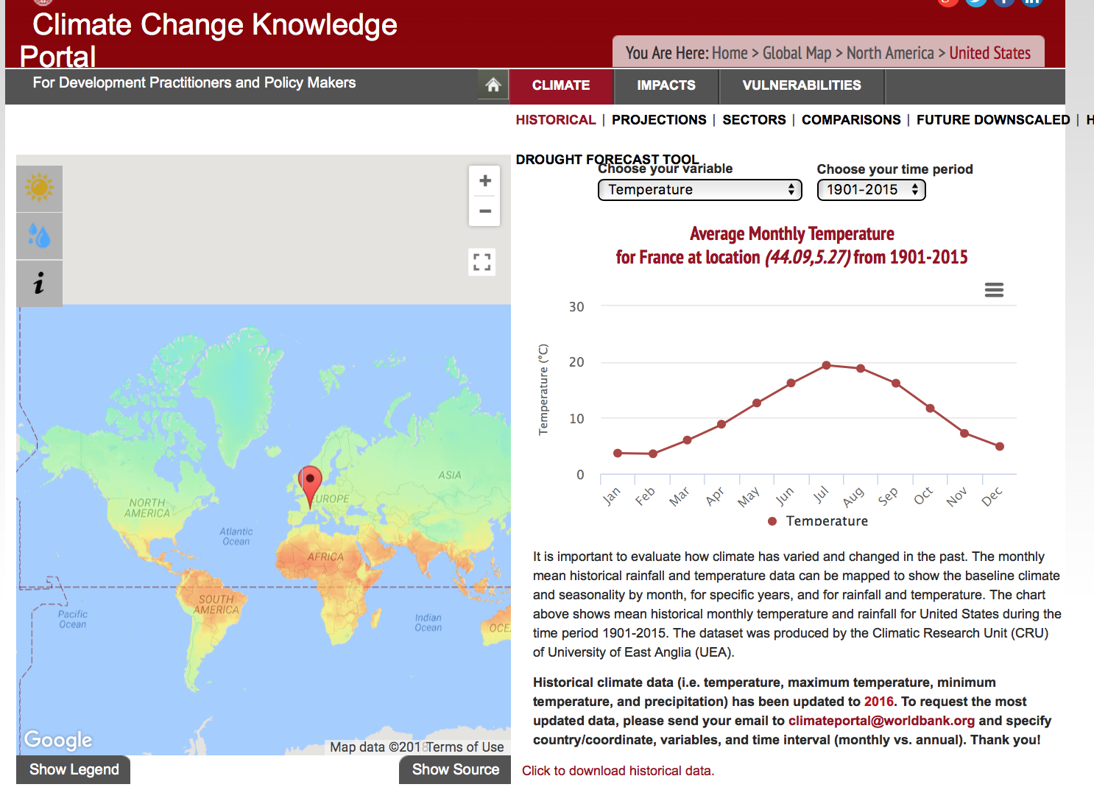
WorldBank Data
Multinational partnership amongst 170 countries worldwide
Seeking to improve improve global welfare.
Akin to the famous CIA World Factbook, the Worldbank provides data repositories for various things:
Population
Health
Social demographics
Economics
Education
Climate data!!

Slide 10
Interfacing via 'wbpy' library
'wbpy' --> class wrapper to access datasets of the Worldbank
Defines multiple .get(foo) functions, where foo is a query on a/many indicator(s) from the World Bank dataset
·population_indicators = api.get_indicators(search="population")
Pros
Single method calls to do the equivalent of multiple API requests, makes for much more readable and repeatable code
Supports both ISO 1366 alpha-2 and alpha-3 country codes. Most standard API wrapper libraries only support alpha-3 ISO codes. i.e. wbpy supports 'legacy format' regarding the ISO-3166 standard
This support of arbitrary inputs would be helpful if say, Sally is elderly and used to the ancient format!
Automatically fills in missing dates within a queried time interval (if necessary)

Slide 11
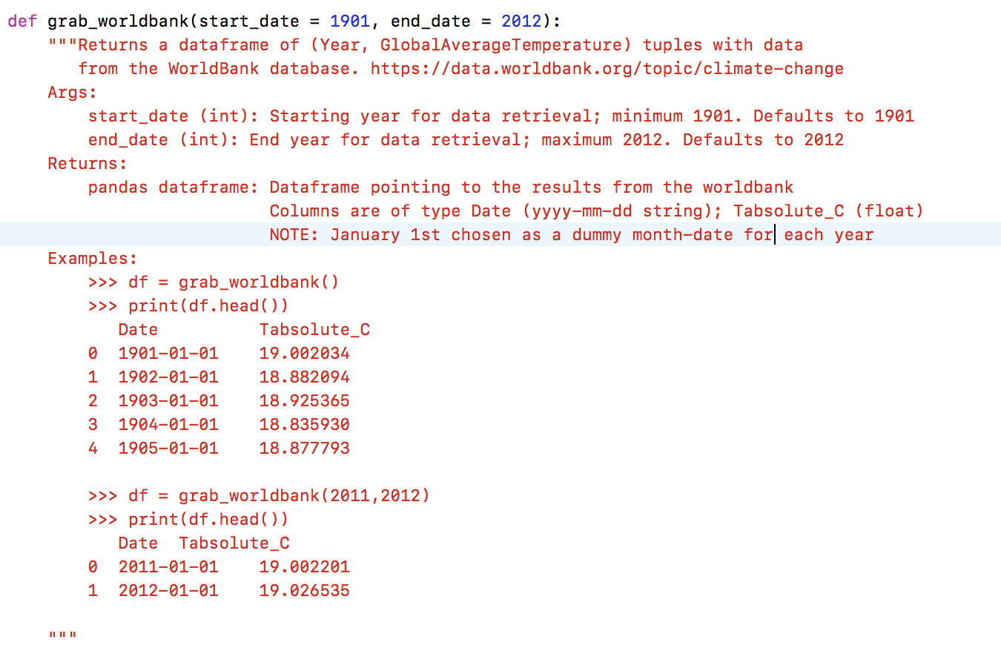

Slide 12
Climate Data: Scripps Institute
Original project design: incorporate auxiliary climate data
Latest climate buzzwords:
Global warming
CO2 emissions
Not assuming any bias or political slant here, but...still...
Exploratory data analysis

Slide 13
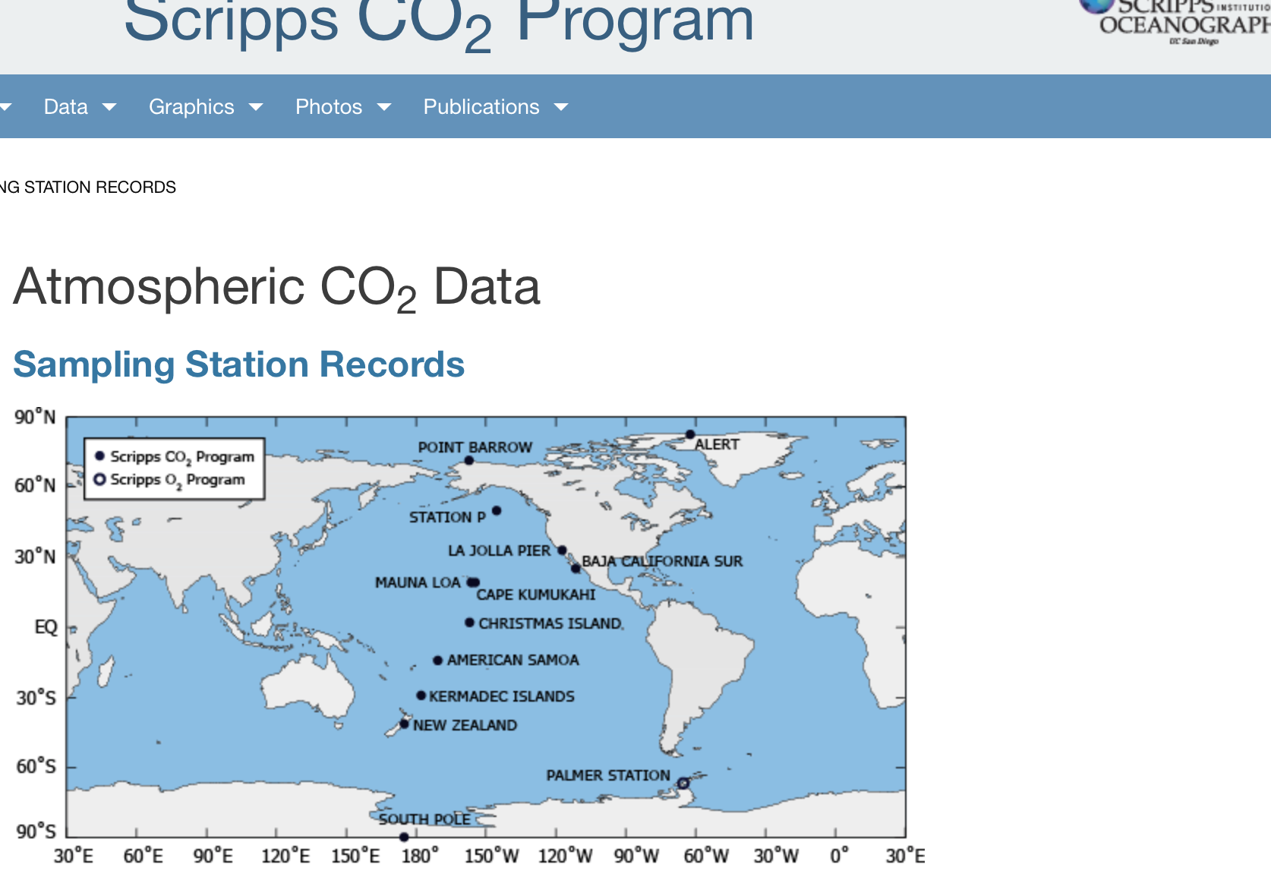
Climate Data: Scripps Institute
The Scripps Institute for Oceanography is a heralded forum for carbon dioxide research.
Founder, Charles Keeling, is considered by many to first have alerted the world to the potential risks of greenhouse gas emissions.
Scripps has several sampling stations in the western hemisphere to gather CO2 data in parts per million

Slide 14
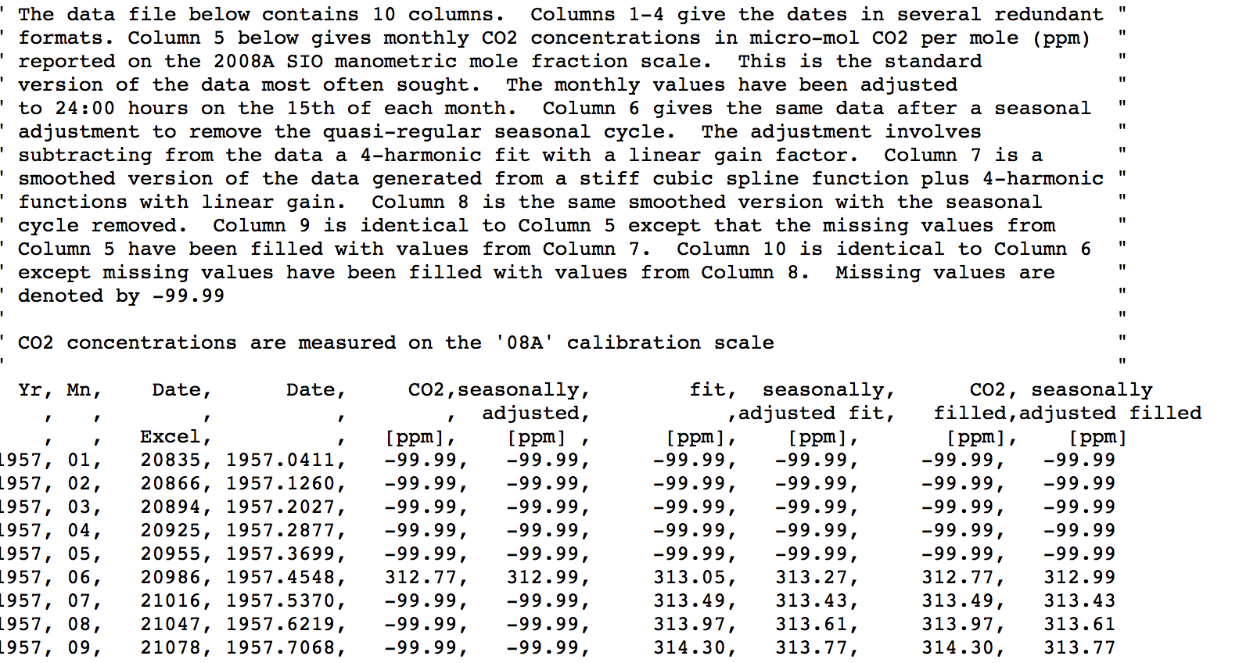
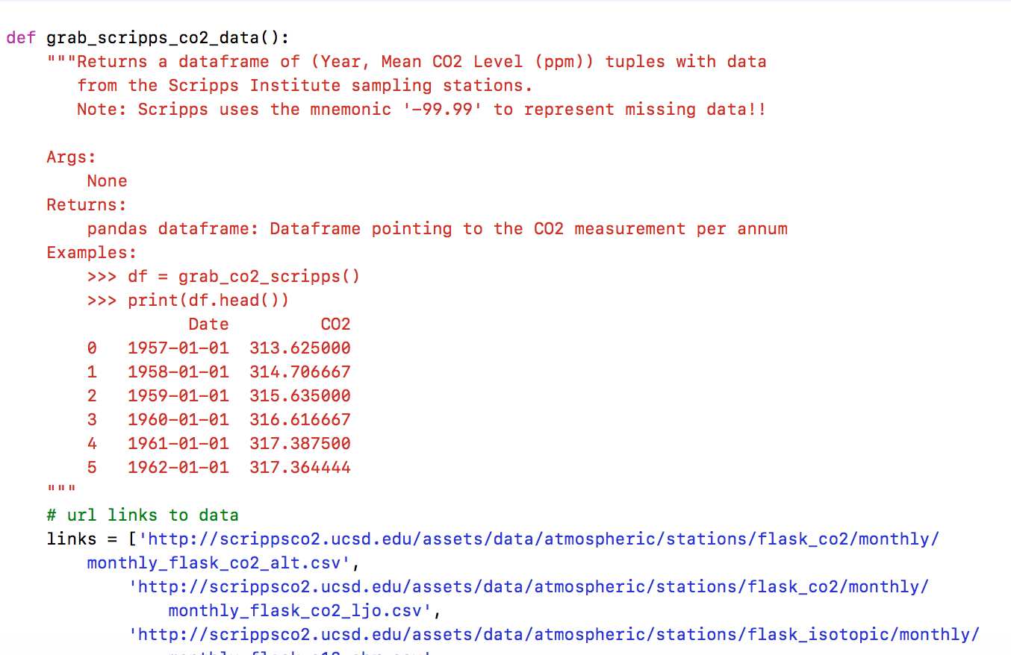

Slide 15
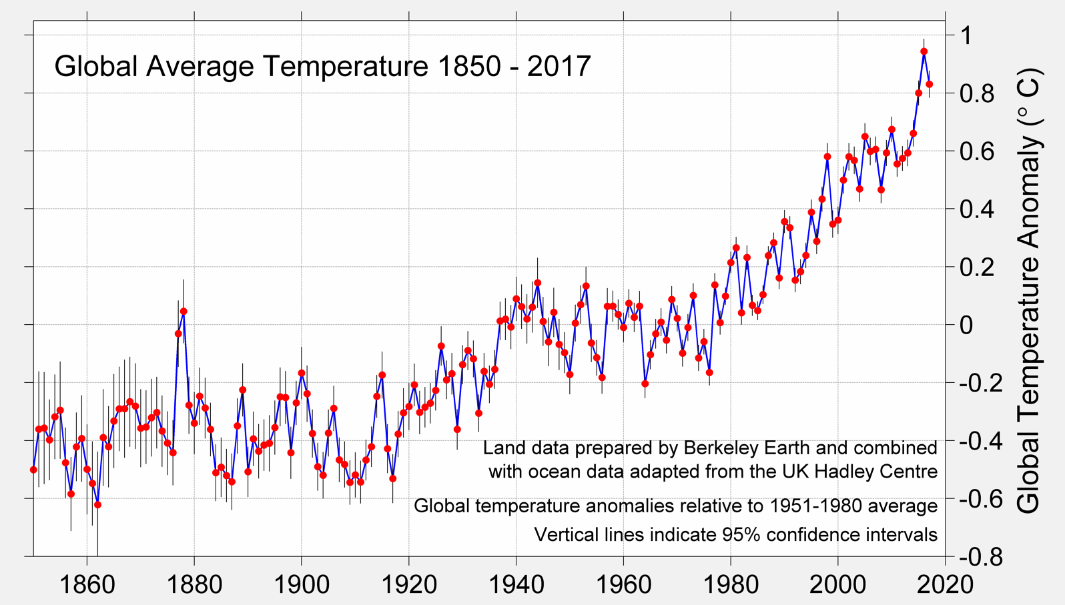
Berkeley Earth A Measured Approach: CLIMATE SCIENCE + STRATEGIC ANALYSIS
Berkeley Earth is independently operated, funded primarily by unrestricted educational grants.
We pursue objectivity without concern for policies of government, industry or philanthropic ventures.
This project was focused mainly on Temperature aspect of climate

Slide 16
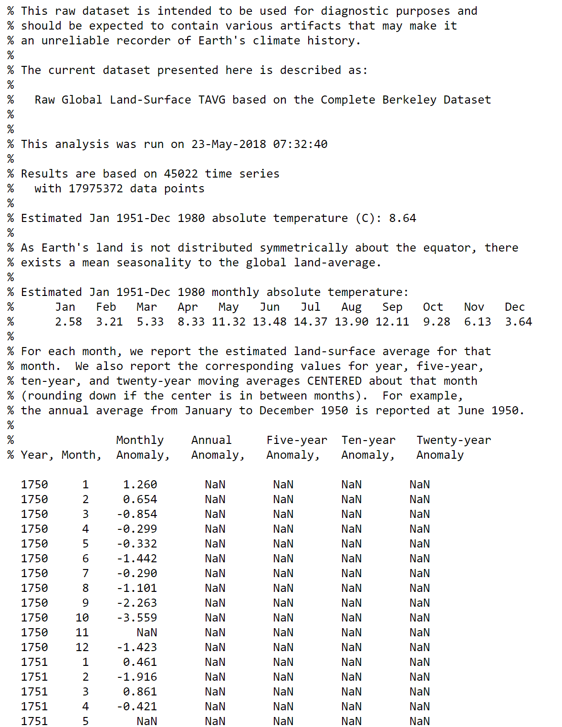
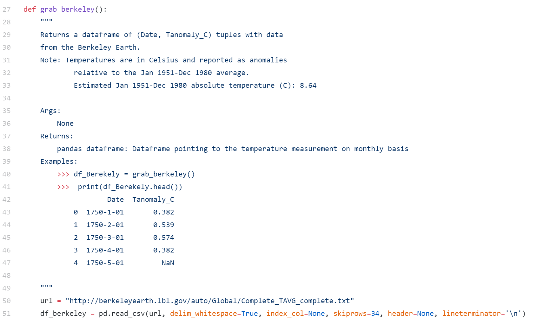

Slide 17
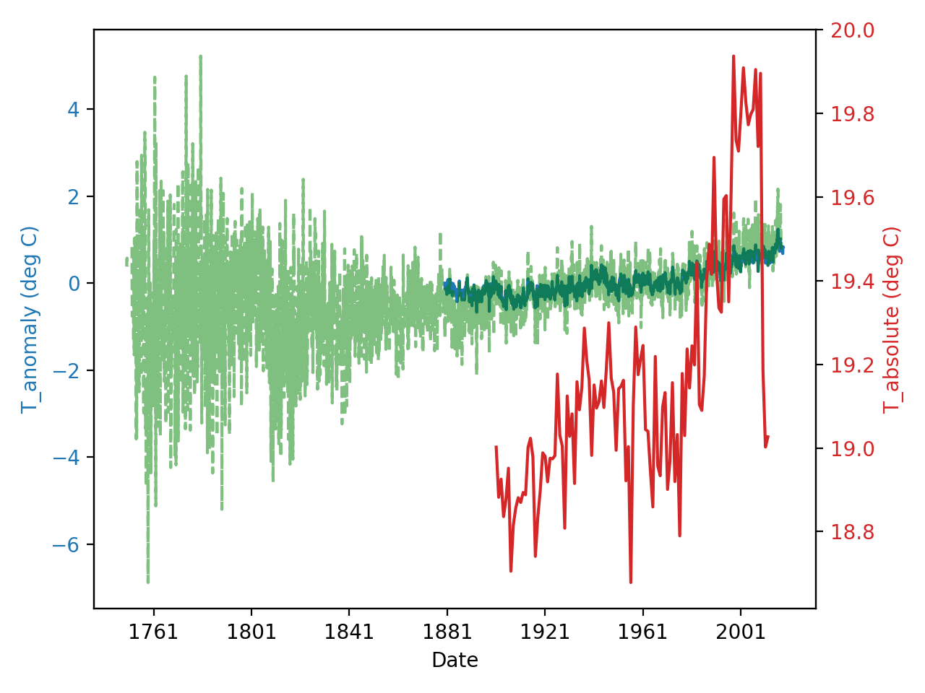
Demo

Slide 18
Design

Slide 19
Project Structure

Slide 20
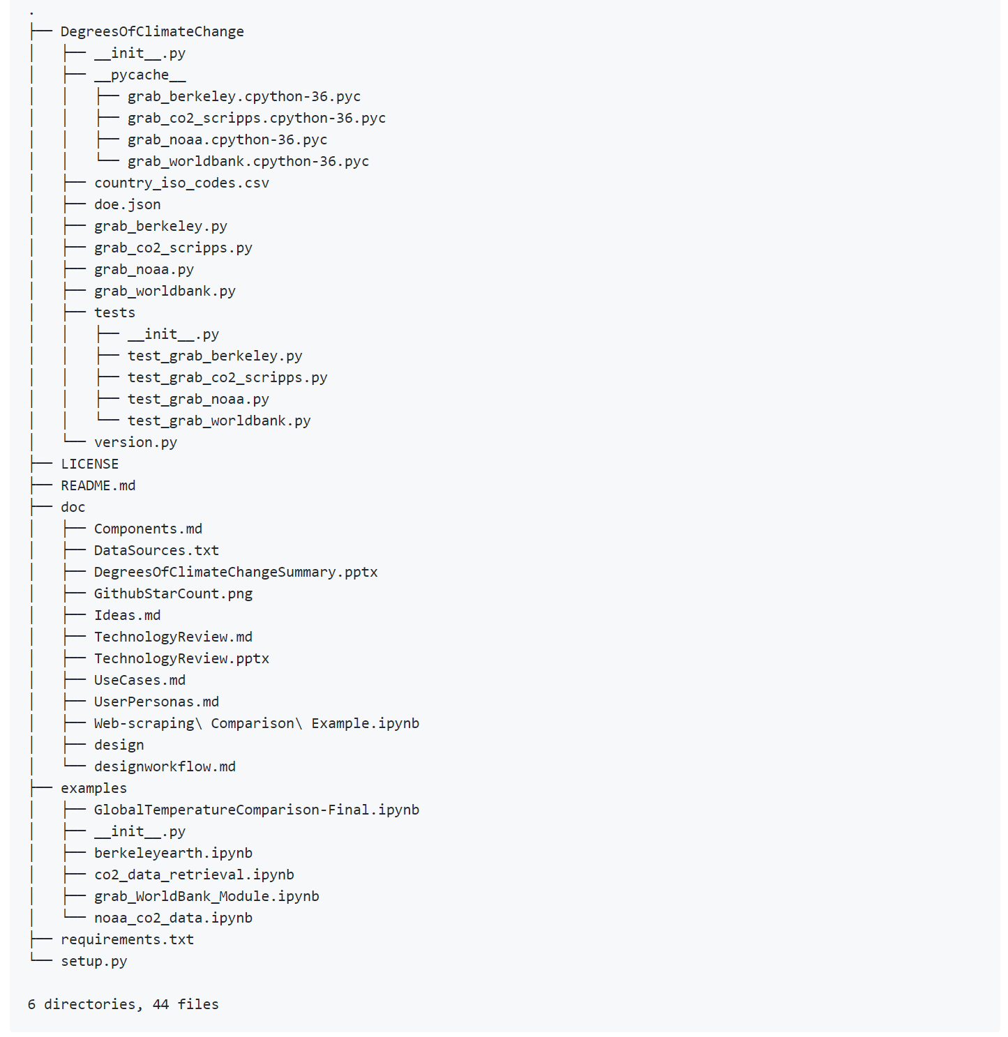
Project Structure

Slide 21
Lessons Learned
Setting up imports to work with modules in different folders can be challenging
Setting up imports to work with Travis CI can be challenging

Slide 22
Future Work
Additional data sources
Increase geopolitical diversity of data source origins
Add potential causal data sources
CO2 emissions
Solar activity
Improve data handling and visualizations
Find consistent estimates of the temperature anomaly instead of mixing deviations with absolute temperature values

Slide 23
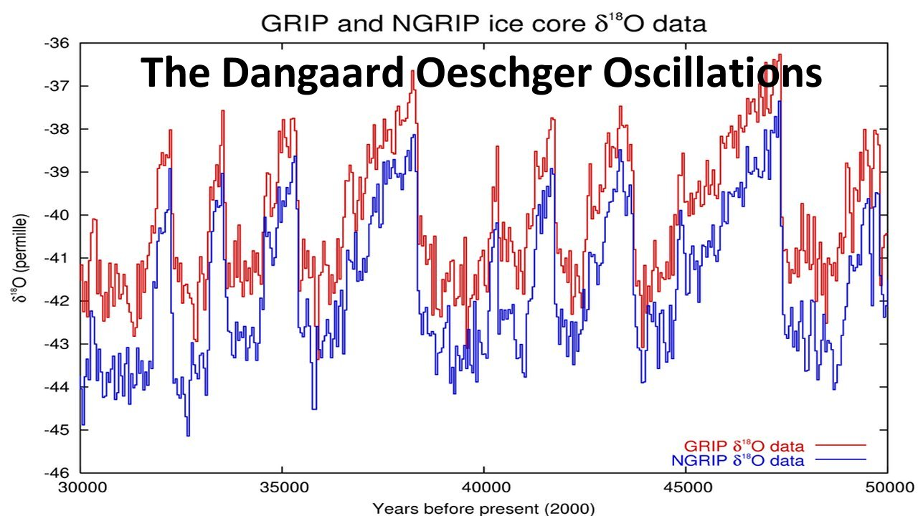
Future Work: Need Longer-Dated Climate & Temperature Data
Temperature Proxy
http://ice-age-ahead-iaa.ca/scrp-awake/laba027.htm

Slide 24
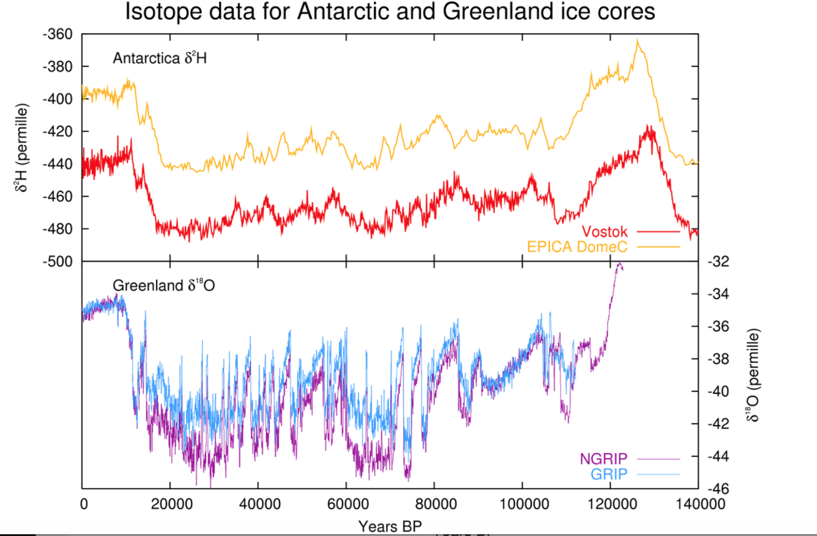
Data does not go back far enough!!
What if......our current data is biased I.e. we are only sampling in an "upswing"
Temperature Proxy
https://en.wikipedia.org/wiki/Dansgaard–Oeschger_event
Present
Prehistoric Age

